Slide 1
Yellow Belt

Slide 2
Red Stripe - Forms
  Kee Cho Hyung Il Boo (Basic Form #1)
  Kee Cho Hyung Ee Boo (Basic Form #2)
  Kee Cho Hyung Sam Boo (Basic Form #3)
White Stripe – One-Step Sparring
  One-Step Sparring 1 – 4
Blue Stripe – Self Defense
  One-Step Sparring 1 – 4
Orange Belt
  Kee Cho Hyung Il Boo One Step Sparring 1 – 4
  Kee Cho Hyung Ee Boo Cross Hand Grips 1 – 4
  Kee Cho Hyung Sam Boo

Slide 3
Red Stripe

Slide 4
Kee Cho Hyung Il Boo

Slide 5





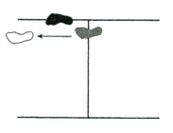
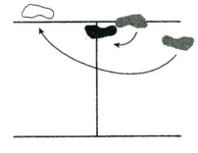
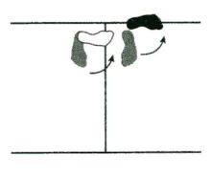
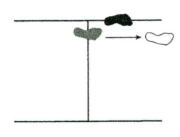
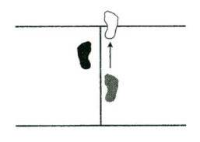

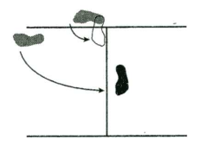
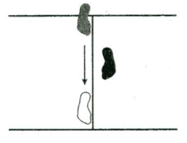
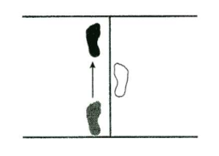


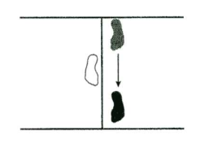
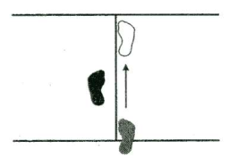
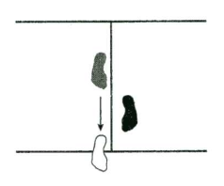
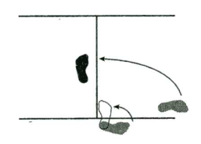

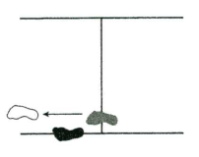
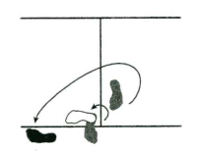
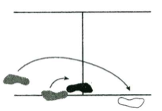
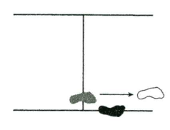

4
3
1
2
5
8
6
7
R
L
7
6
8
5
2
1
3
4

Slide 6
Ready Stance
{…….} = Preparation movements
(……..) = where your foot should be placed on the clock face
Bring your *left hand to your Right shoulder*
  *stinky sock* Look over your Left shoulder
  *The shoulder that I look over is the foot that I move* Turn 90° to the Left Step forward with your Left foot into a Front Stance (w/ your Left foot on #10)
  Left hand Low Block
Step forward (w/ right foot onto #2) into a Front Stance, Right Hand Middle Punch
*Punch hand to the Left shoulder*
  *stinky sock* Look over your Right shoulder
  *The shoulder that I look over is the foot that I move* lifting the foot of the shoulder you are looking over (right foot) Turn 180° to the Right, Right foot Front Stance (make sure your Right foot is on the new #2)
  Right hand Low Block
Step forward (w/ left foot onto #10) into a Front Stance
  Left hand Middle Punch

Slide 7
Punch hand to the Right shoulder
  *stinky sock* Look over your Left shoulder lifting the foot of the shoulder you are looking over *left foot* Turn Left 90° (w/ left foot onto the new #10) in a Front Stance
  Left Hand Low Block
Step forward (w/ right foot onto #2) into a Front Stance
  Right Hand Middle Punch
Step forward (w/ left foot onto #10) into a Front Stance
  Left hand Middle Punch
Step forward (w/ right foot onto #2) into a Front Stance
  Right Hand Middle Punch, Keop

Slide 8
Second Half
Bring your *left hand to your Right shoulder*
  *stinky sock* Look over your Left shoulder (to the #3)
  *The shoulder that I look over is the foot that I move* Turn 90°(if looking over your rear shoulder to the #3) or a 225° (if looking strait) with your Left foot into a Front Stance (w/ your Left foot on #10)
  Left hand Low Block
Step forward (w/ right foot onto #2) into a Front Stance, Right Hand Middle Punch
*Punch hand to the Left shoulder*
  *stinky sock* Look over your Right shoulder
  *The shoulder that I look over is the foot that I move* lifting the foot of the shoulder you are looking over (right foot) Turn 180° to the Right, Right foot Front Stance (make sure your Right foot is on the new #2)
  Right hand Low Block
Step forward (w/ left foot onto #10) into a Front Stance
  Left hand Middle Punch

Slide 9
Punch hand to the Right shoulder
  *stinky sock* Look over your Left shoulder lifting the foot of the shoulder you are looking over *left foot* Turn Left 90° (w/ left foot onto the new #10) in a Front Stance
  Left Hand Low Block
Step forward (w/ right foot onto #2) into a Front Stance
  Right Hand Middle Punch
Step forward (w/ left foot onto #10) into a Front Stance
  Left hand Middle Punch
Step forward (w/ right foot onto #2) into a Front Stance
  Right Hand Middle Punch, Keop

Slide 10
Last 4 Movements
Bring your *left hand to your Right shoulder*
  *stinky sock* Look over your Left shoulder (to the #3)
  *The shoulder that I look over is the foot that I move* Turn 90°(if looking over your rear shoulder to the #3) or a 225° (if looking strait) with your Left foot into a Front Stance (w/ your Left foot on #10)
  Left hand Low Block
Step forward (w/ right foot onto #2) into a Front Stance, Right Hand Middle Punch
*Punch hand to the Left shoulder*
  *stinky sock* Look over your Right shoulder
  *The shoulder that I look over is the foot that I move* lifting the foot of the shoulder you are looking over (right foot) Turn 180° to the Right, Right foot Front Stance (make sure your Right foot is on the new #2)
  Right hand Low Block
Step forward (w/ left foot onto #10) into a Front Stance
  Left hand Middle Punch

Slide 11
Kee Cho Hyung Ee Boo

Slide 12
Ready Stance
{…….} = Preparation movements
(……..) = where your foot should be placed on the clock face
Bring your *left hand to your Right shoulder*
  *stinky sock* Look over your Left shoulder
  *The shoulder that I look over is the foot that I move* Turn 90° to the Left Step forward with your Left foot into a Front Stance (w/ your Left foot on #10)
  Left hand Low Block
Step forward (w/ right foot onto #2) into a Front Stance
  Right Hand High Punch
*Punch hand to the Left shoulder*
  *stinky sock* Look over your Right shoulder
  *The shoulder that I look over is the foot that I move* lifting the foot of the shoulder you are looking over (right foot) Turn 180° to the Right, Right foot Front Stance (make sure your Right foot is on the new #2)
  Right hand Low Block
Step forward (w/ left foot onto #10) into a Front Stance
  Left hand High Punch

Slide 13
Punch hand to the Right shoulder
  *stinky sock* Look over your Left shoulder lifting the foot of the shoulder you are looking over *left foot* Turn Left 90° (w/ left foot onto the new #10) in a Front Stance
  Left Hand Low Block
Step forward (w/ right foot onto #2) into a Front Stance
  Right Hand High Block
Step forward (w/ left foot onto #10) into a Front Stance
  Left hand High Block
Step forward (w/ right foot onto #2) into a Front Stance
  Right Hand High Block, Keop

Slide 14
Second Half
Bring your *left hand to your Right shoulder*
  *stinky sock* Look over your Left shoulder (to the #3)
  *The shoulder that I look over is the foot that I move* Turn 90°(if looking over your rear shoulder to the #3) or a 225° (if looking strait) with your Left foot into a Front Stance (w/ your Left foot on #10)
  Left hand Low Block
Step forward (w/ right foot onto #2) into a Front Stance
  Right Hand High Punch
*Punch hand to the Left shoulder*
  *stinky sock* Look over your Right shoulder
  *The shoulder that I look over is the foot that I move* lifting the foot of the shoulder you are looking over (right foot) Turn 180° to the Right, Right foot Front Stance (make sure your Right foot is on the new #2)
  Right hand Low Block
Step forward (w/ left foot onto #10) into a Front Stance
  Left hand High Punch

Slide 15
Punch hand to the Right shoulder
  *stinky sock* Look over your Left shoulder lifting the foot of the shoulder you are looking over *left foot* Turn Left 90° (w/ left foot onto the new #10) in a Front Stance
  Left Hand Low Block
Step forward (w/ right foot onto #2) into a Front Stance
  Right Hand High Block
Step forward (w/ left foot onto #10) into a Front Stance
  Left hand High Block
Step forward (w/ right foot onto #2) into a Front Stance
  Right Hand High Block, Keop

Slide 16
Last 4 Movements
Bring your *left hand to your Right shoulder*
  *stinky sock* Look over your Left shoulder (to the #3)
  *The shoulder that I look over is the foot that I move* Turn 90°(if looking over your rear shoulder to the #3) or a 225° (if looking strait) with your Left foot into a Front Stance (w/ your Left foot on #10)
  Left hand Low Block
Step forward (w/ right foot onto #2) into a Front Stance, Right Hand High Punch
*Punch hand to the Left shoulder*
  *stinky sock* Look over your Right shoulder
  *The shoulder that I look over is the foot that I move* lifting the foot of the shoulder you are looking over (right foot) Turn 180° to the Right, Right foot Front Stance (make sure your Right foot is on the new #2)
  Right hand Low Block
Step forward (w/ left foot onto #10) into a Front Stance
  Left hand High Punch

Slide 17
Kee Cho Hyung Sam Boo

Slide 18
Ready Stance
{…….} = Preparation movements
(……..) = where your foot should be placed on the clock face
*LICK THE LOLLY POP* Bring your left hand to your Right hip and your Right hand to your Left shoulder
  Turn 90° to the Left into a Back Stance with your Left foot (Left foot on the new #12)
  Left hand Middle Block
Step Forward (w/ right foot onto #12)
  Right hand Side Punch in a Horse Stance
*LICK THE LOLLY POP* Punch hand to the Left hip and you Left hand to the right shoulder
  *The shoulder that I look over is the foot that I move* Look over your Right shoulder lifting the foot of the shoulder you are looking over (right foot) Turn Right 180° to the Right, Right foot Back Stance (make sure your Right foot is on the new #12)
  Right hand Middle Block
Step Forward (w/ left foot onto #12)
  Left Side Punch, in a Horse Stance

Slide 19
*Punch hand to the Right shoulder*
  *stinky sock* Look over your Left shoulder
  *The shoulder that I look over is the foot that I move* lifting the foot of the shoulder you are looking over *left foot*} Turn Right Left 90° (w/ left foot onto the new #10) in a Front Stance
  Left Hand Low Block
Step Forward (w/ right foot onto #12),
  Right Side Punch in a Horse Stance
Step Forward (w/ left foot onto #12)
  Left Side Punch in a Horse Stance
Step Forward (w/ right foot onto #12)
  Right Side Punch in a Horse Stance, Keop

Slide 20
Second Half
*LICK THE LOLLY POP* Bring your left hand to your Right hip and your Right hand to your Left shoulder (look over your Left shoulder to the # 3)
  Turn 90°(if you are looking over the back shoulder to the #3) or(225°turn if you are looking strait ahead) to the Left into a Back Stance with your Left foot (Left foot on the new #12)
  Left hand Middle Block
Step Forward (w/ right foot onto #12)
  Right hand Side Punch in a Horse Stance
*LICK THE LOLLY POP* Punch hand to the Left hip and you Left hand to the right shoulder
  *The shoulder that I look over is the foot that I move* Look over your Right shoulder lifting the foot of the shoulder you are looking over (right foot) Turn Right 180° to the Right, Right foot Back Stance (make sure your Right foot is on the new #12)
  Right hand Middle Block
Step Forward (w/ left foot onto #12)
  Left Side Punch, in a Horse Stance

Slide 21
*Punch hand to the Right shoulder*
  *stinky sock* Look over your Left shoulder
  *The shoulder that I look over is the foot that I move* lifting the foot of the shoulder you are looking over *left foot*} Turn Right Left 90° (w/ left foot onto the new #10) in a Front Stance
  Left Hand Low Block
Step Forward (w/ right foot onto #12),
  Right Side Punch in a Horse Stance
Step Forward (w/ left foot onto #12)
  Left Side Punch in a Horse Stance
Step Forward (w/ right foot onto #12)
  Right Side Punch in a Horse Stance, Keop

Slide 22
Last Four
*LICK THE LOLLY POP* Bring your left hand to your Right hip and your Right hand to your Left shoulder (look over your Left shoulder to the # 3)
  Turn 90°(if you are looking over the back shoulder to the #3) or(225°turn if you are looking strait ahead) to the Left into a Back Stance with your Left foot (Left foot on the new #12)
  Left hand Middle Block
Step Forward (w/ right foot onto #12)
  Right hand Side Punch in a Horse Stance
*LICK THE LOLLY POP* Punch hand to the Left hip and you Left hand to the right shoulder
  *The shoulder that I look over is the foot that I move* Look over your Right shoulder lifting the foot of the shoulder you are looking over (right foot) Turn Right 180° to the Right, Right foot Back Stance (make sure your Right foot is on the new #12)
  Right hand Middle Block
Step Forward (w/ left foot onto #12)
  Left Side Punch, in a Horse Stance

Slide 23
White Stripe

Slide 24
One-Step Sparring
# 1

Slide 25
Counts
Step forward with right foot (on 45 degree angle [the #2 on the clock]) in a Front Stance.
  Reverse middle knife hand block w/ left hand
Two punches
  First “Middle punch” to the solar plexus with the front hand
  Second “High punch” to the nose with the rear hand
Shift your left foot behind right foot into a fighting stance.
  (your right shoulder is facing you target)
Right leg roundhouse kick to stomach or head. “Keop”

Slide 26
One-Step Sparring
# 2

Slide 27
Counts
Step forward with Left foot (on 45 degree angle [the #10 on the clock]) in a Front Stance.
  Reverse middle knife hand block w/ Right hand
Two punches
  First “Middle punch” to the solar plexus with the front hand
  Second “High punch” to the nose with the rear hand
Shift your Right foot behind Left foot into a fighting stance.
  (your left shoulder is facing you target)
Left leg roundhouse kick to stomach or head. “Keop”

Slide 28
One-Step Sparring
#3

Slide 29
Counts
Step forward w/ right foot on the #2 (same as one step #1)
  doing a outside to inside block w/ your right hand
  (at the same time)pivoting your hips and belt to get the knot on your belt and your chest to face the #9 in a front stance.
Two punches
  first “Reverse punch” to the solar plexus pivot back to the front facing #12
  second “Jab” to the nose pivot back to the left facing #9
Drag left foot behind left foot.
  (facing you target)
Right leg side kick to the stomach. Keop

Slide 30
One-Step Sparring
#4

Slide 31
Counts
Step forward w/ left foot on the #10 (same as one step #2)
  doing a outside to inside block w/ your left hand
  (at the same time)pivoting your hips and belt to get the knot on your belt and your chest to face the #3 in a front stance.
Two punches
  first “Reverse punch” to the solar plexus pivot back to the front facing #12
  second “Jab” to the nose pivot back to the right facing #3
Drag left foot behind right foot.
  (facing you target)
Left leg side kick to the stomach. Keop

Slide 32
Blue Stripe

Slide 33
Self-Defense
Cross Hand Grip
# 1

Slide 34
Counts
Step out with your left leg (on to # 10 of the clock) into a front stance,
  Circle your hand to the right and up moving (from the outside to the inside of the body (like waving hi) with your right hand).
  Bring your hand to your heart.
“Chop”
  Soo do chop with your right hand to the attacker’s neck.
“Stop”
  Pivot your stance to the other direction, doing a left palm heel attack to the spot in between the attacker’s nose and upper lip (where the mustache grows).
“OOO I got your belt”
  With your right hand do a palm heel to the knot on your opponent’s belt; grab their knot and pull, extending your left hand to stop the attacker from coming forward.

Slide 35
Self-Defense
Cross Hand Grip
# 2

Slide 36
Count #1
Bring your left hand to your right shoulder
  Step out with your right foot (on to # 2 of the clock) into a front stance
  performing a scissors action with your hands striking your attacker with your left hand with a “CHOP” soo do to the neck as the right hand
  palm facing up, extends in the opposite direction twisting your body.
*remember, we are not superstars!*
*Serve the pizza, Take it away*
“STOP”
  Right palm heel to the spot in between the nose and upper lip, pivoting your stance to the opposite direction.
“OOO I GOT YOUR BELT”
  With you left hand do a palm heel to the knot on your opponent’s belt; grab their knot and pull, extending your right hand to stop the attacker from coming forward.

Slide 37
Self-Defense
Cross Hand Grip
# 3

Slide 38
Counts:
Circle your right hand in a small circle (outward and upward so that your finger tips are in-line with your nose (same as #1))
  grabbing your opponents right hand with your left (your fingers on the inside of their palm and your thumb on the back of their palm on the sensei dots {like pac-man, Waka waka waka})
  twist their wrist using your right forearm for pressure.
Cross-stepping with your right foot (to the #10 on the clock face next to attackers foot)
  twist their wrist using your right forearm for pressure (across the attacker knuckles even with the sensei dots)(stinky arm pit, bring the elbow down)
Using your right arm, elbow the attacker in the nose.
Release the attackers hand
  brace your left hand with your right hand, and spin over your left side elbowing the attacker in the solar plexus.

Slide 39
Self-Defense
Cross Hand Grip
# 4

Slide 40
Counts:
Grab your attackers right wrist with your right hand (while they still have your wrist) then grab it with your left hand (so that both hands have a hold of the same wrist) {like grabbing a light saber *Shoom*}
  stepping across with your left foot into a horse stance (to the number 2 on the clock face next to attackers foot)
  twist your hips sharply to pop your attackers elbow with your elbow (keeping their hand at the level of your belly button).
Pivoting your stance and body to face the #6 on the clock face
  bring your opponents arm over your head {like looking at the stars with a telescope} (make sure to slide their elbow across the back of your shoulders)
  Drag the stars across the sky ( so you are in a front stance facing the #6)
Taking your right foot and step back (in the same direction as your first step onto the #2)
  pulling down on your opponent’s hands so that your elbow and theirs are together and hands are at chest height (lowering their head down.)
Head butt. Keop!!!!

